Slide 1
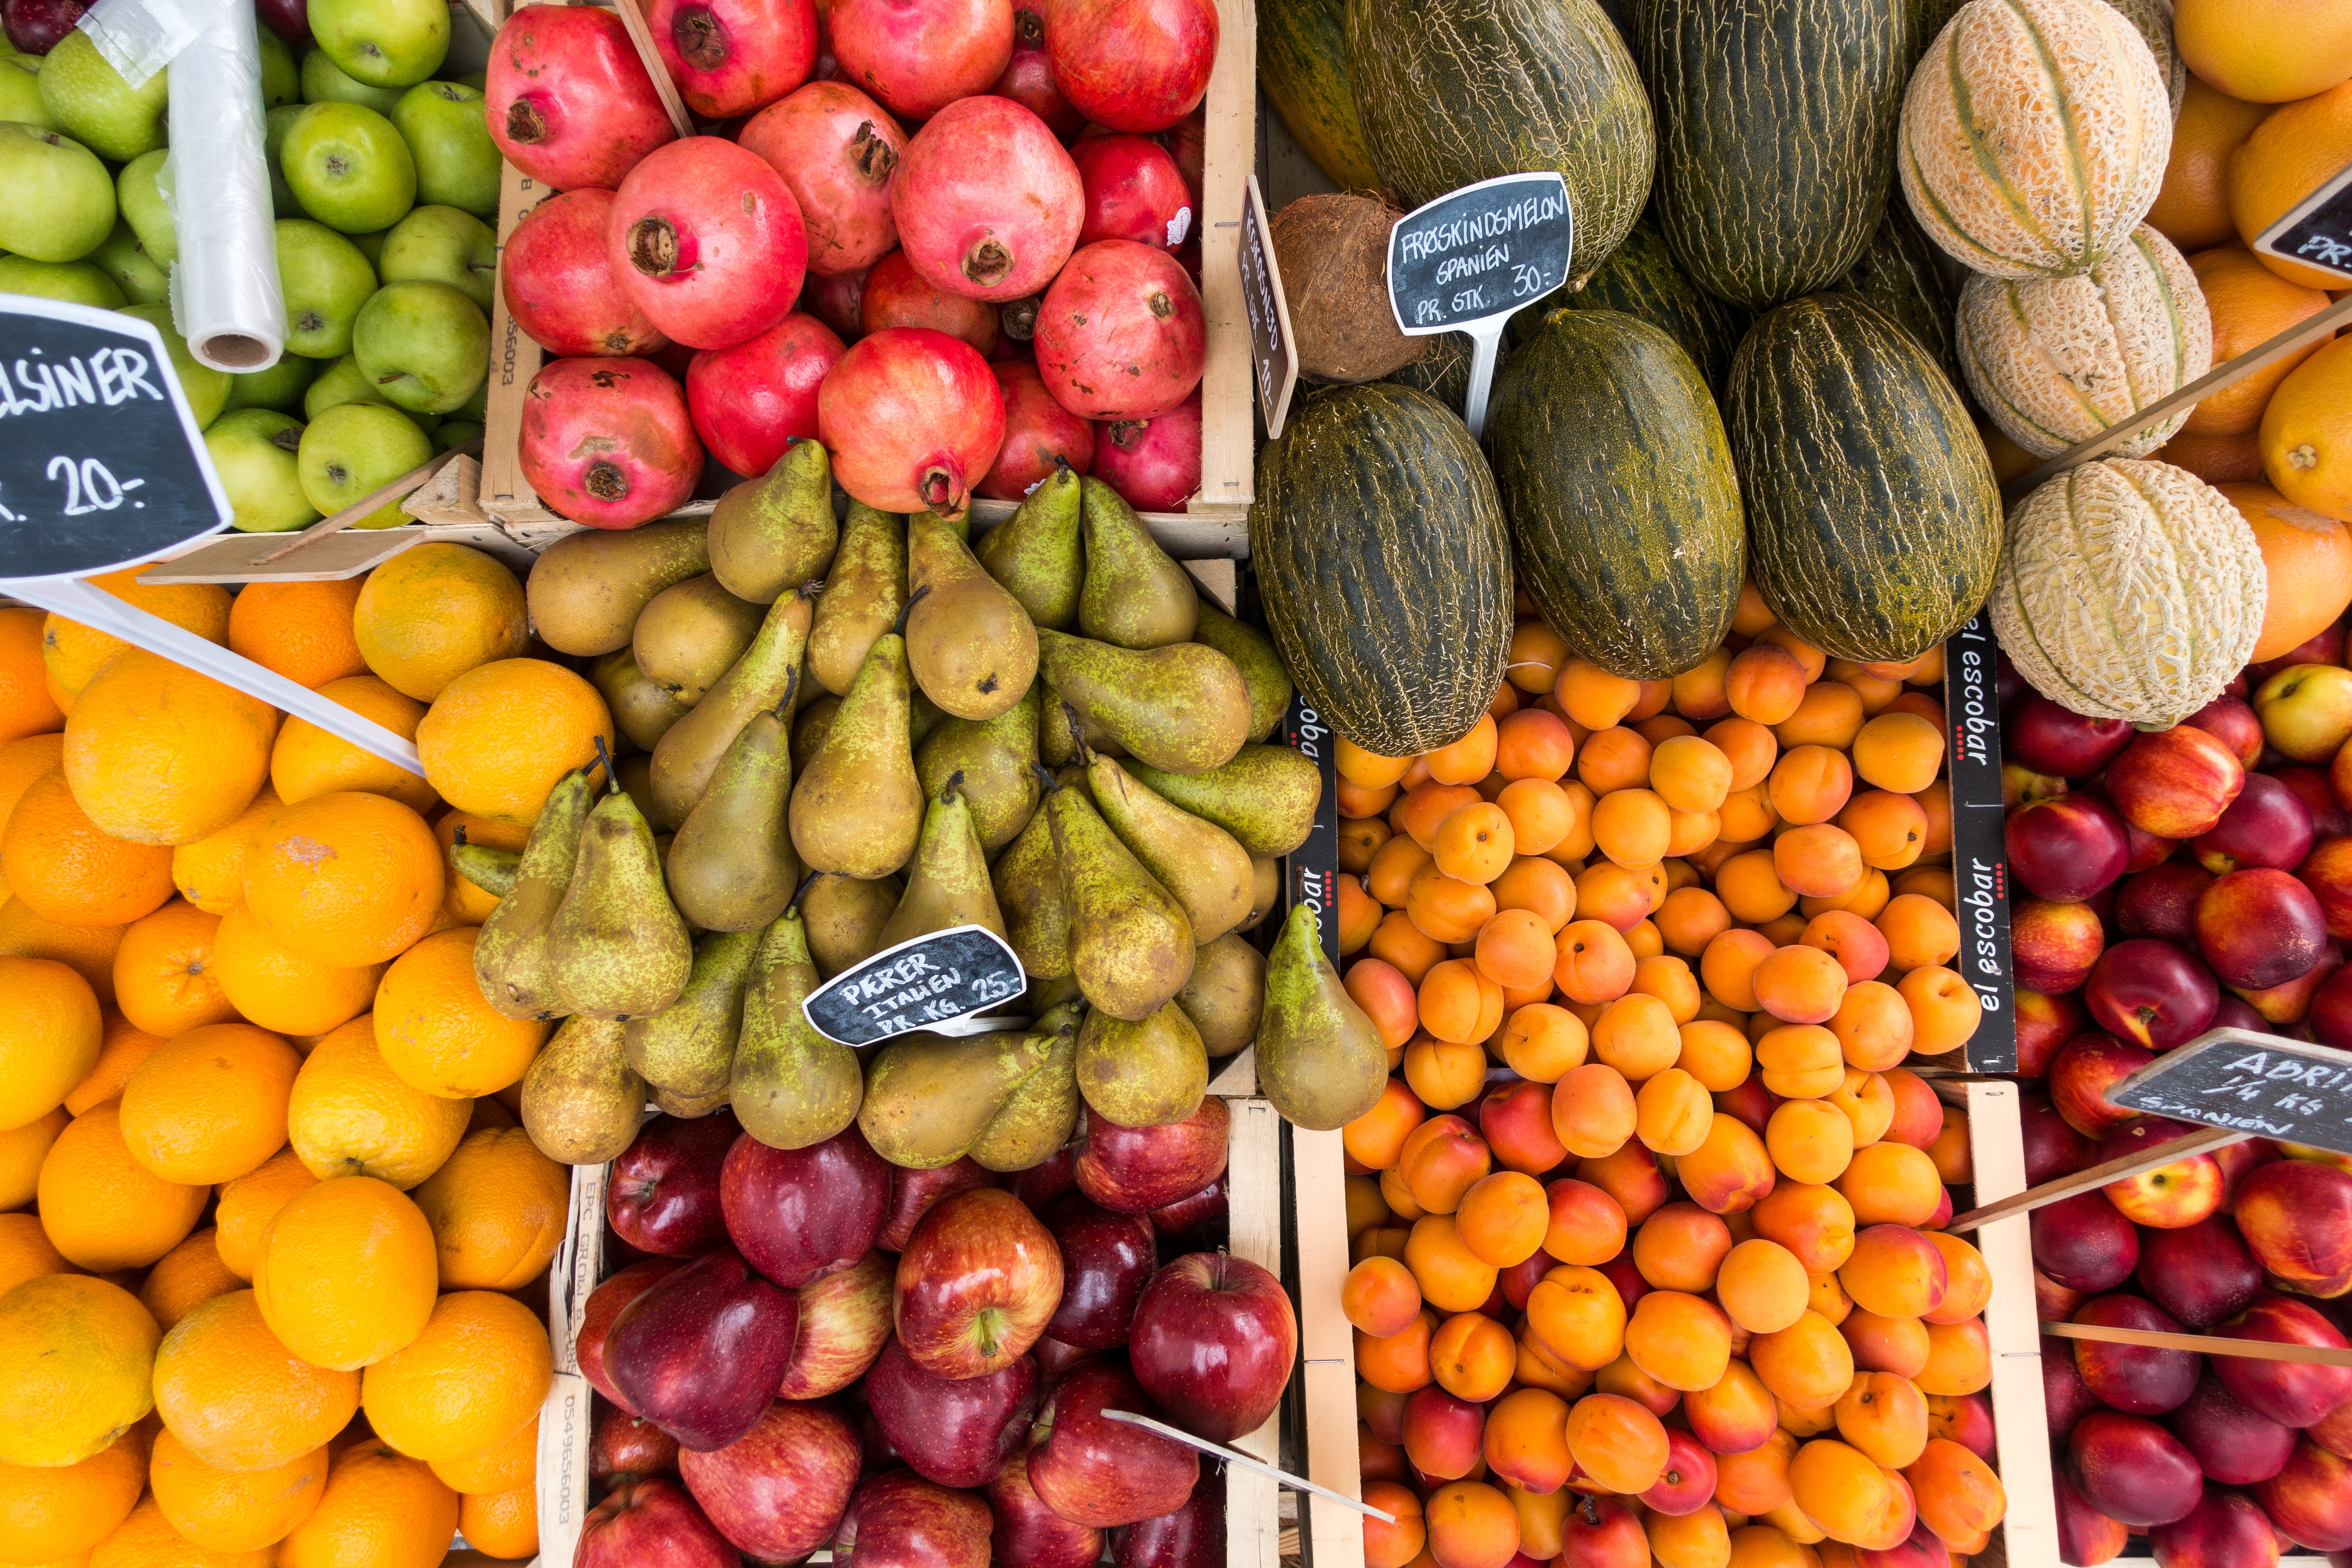
A study of Farmers’ Markets and the prevalence of obesity in US Cities
Presented by Brad Marchant, Maxwell Oteng, Celine Cai & Sonia Gupta

Slide 2
Obesity
Farmers’ Markets
In 2018, 42.4% of adult Americans were considered Obese.
Insufficient fruit and vegetable consumption is one of the contributing factors to Obesity.
Farmers’ markets provide access to fresh and nutritious foods and support healthy communities.
The number of farmers’ markets in the United States has grown by 76 percent since 2008.
Notes:
Obesity fact-CDC
Number of farmers markets-USDA

Slide 3

Question of interest: Do cities with farmers’ markets have a lower obesity rate?

Slide 4



Data Sources

Slide 5
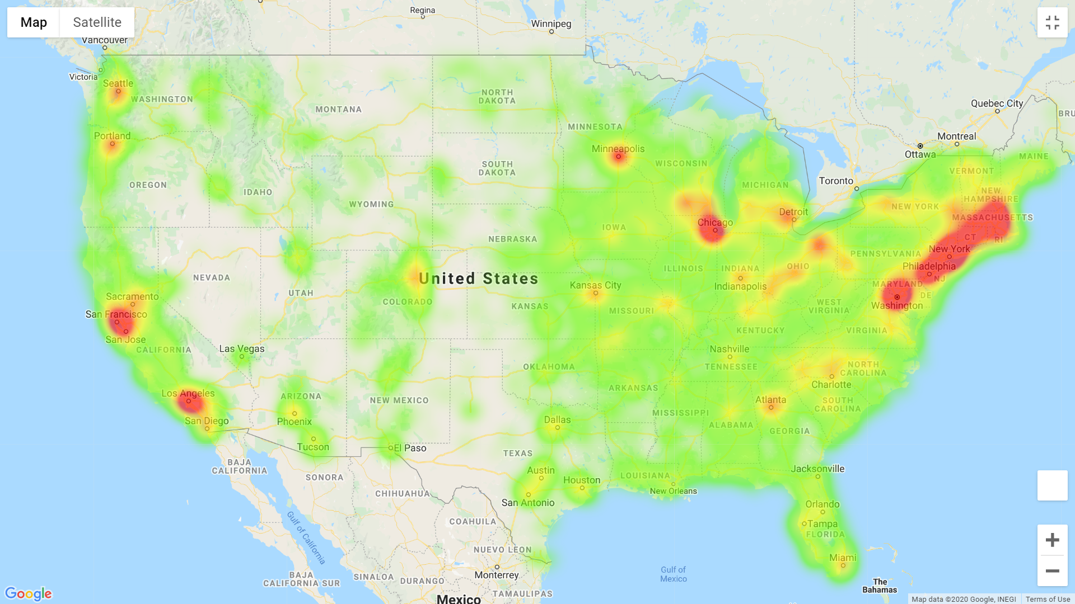
Heat Map of Farmers’ Markets in the US

Slide 6
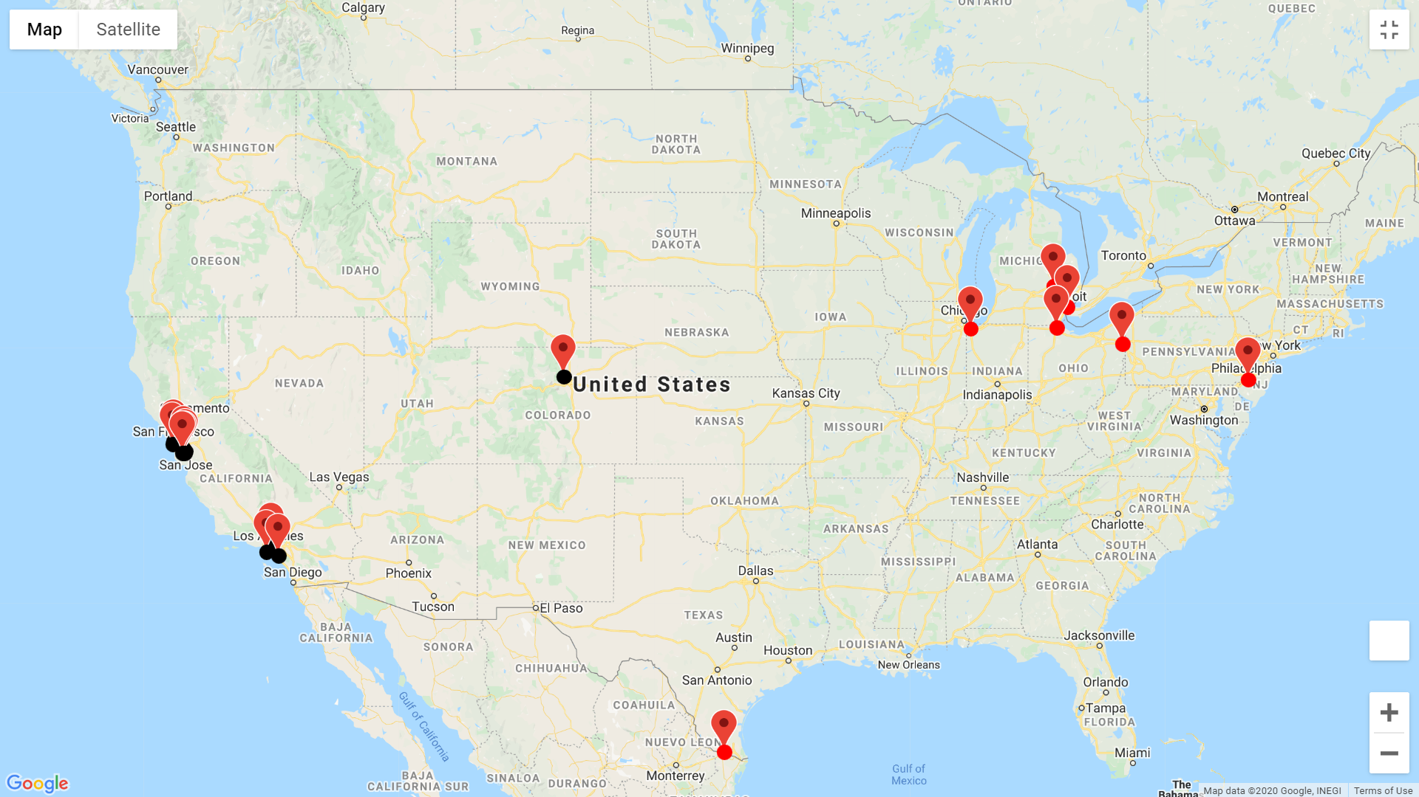
Location of top and bottom 1% of Obesity rate.

Slide 7
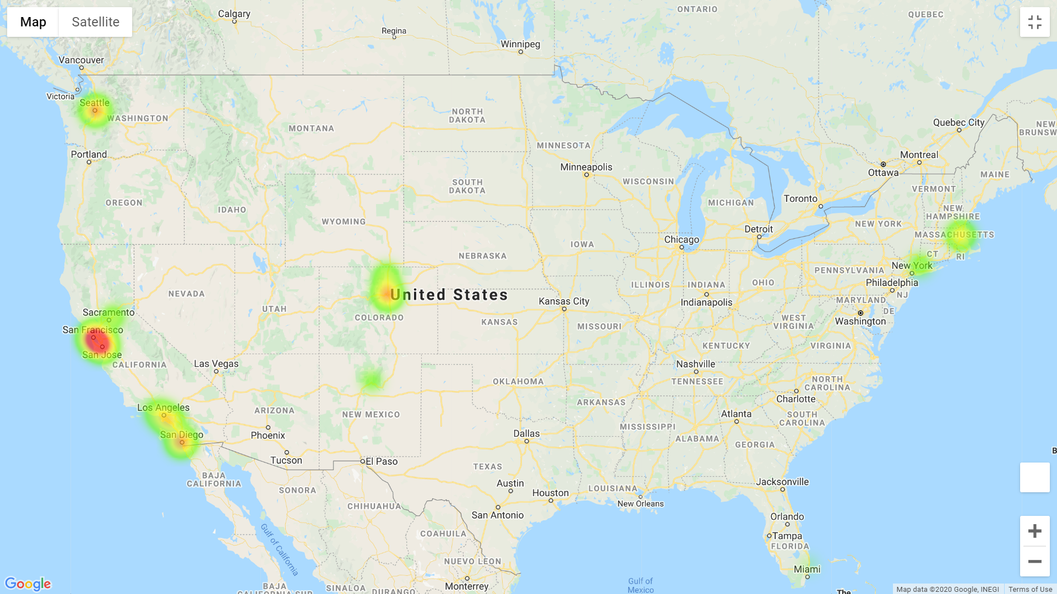
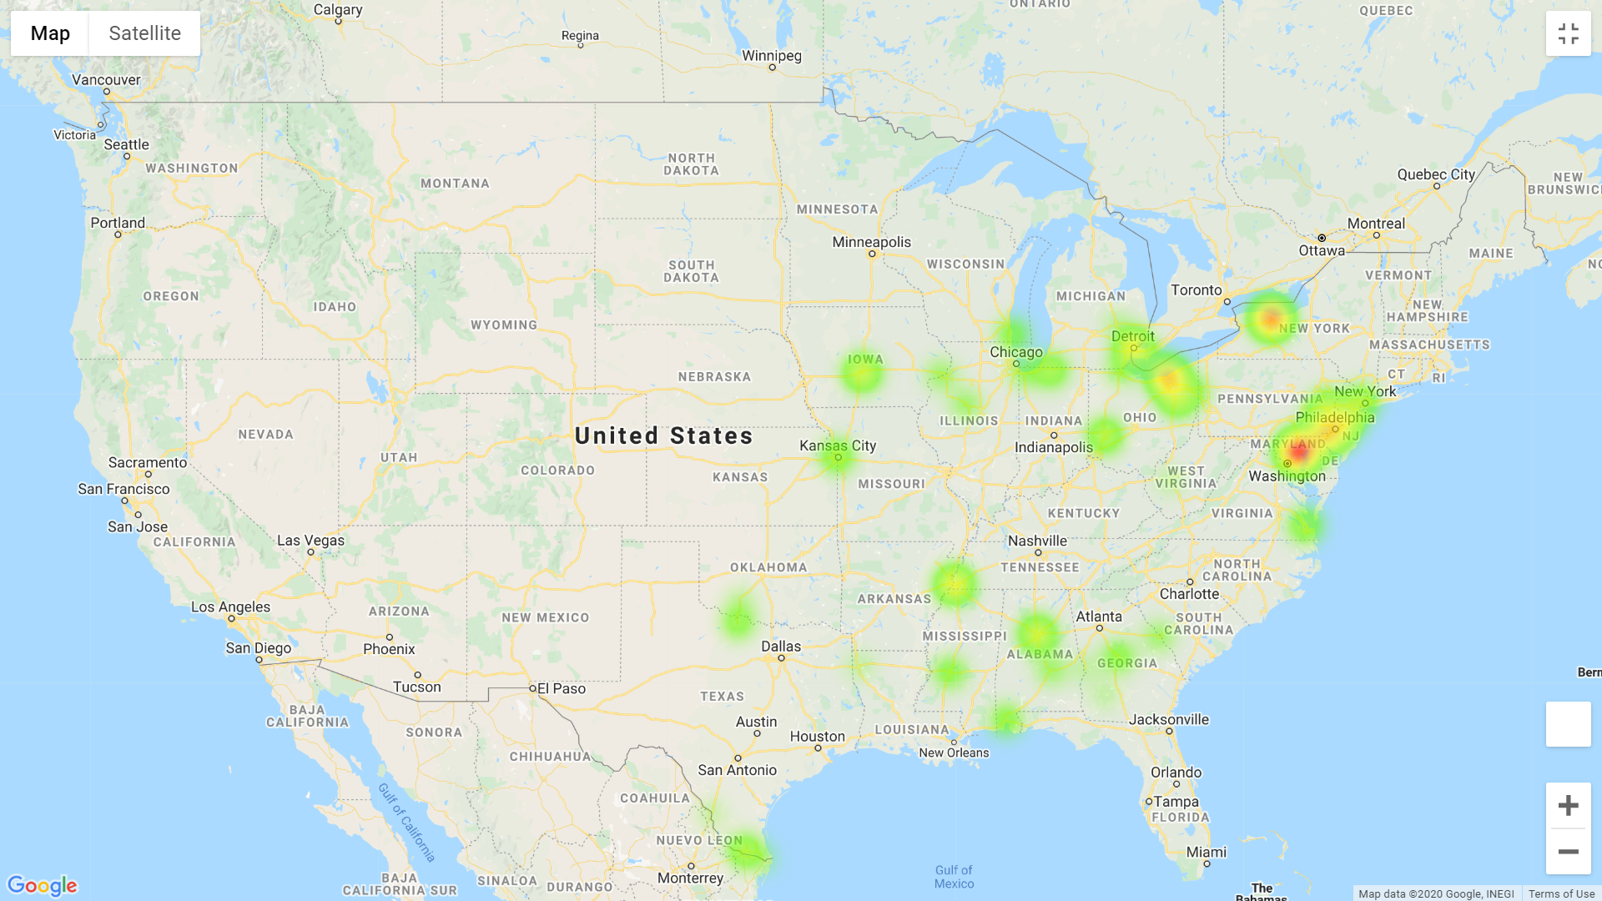
Number of Farmers’ in relation to Obesity rate

Slide 8
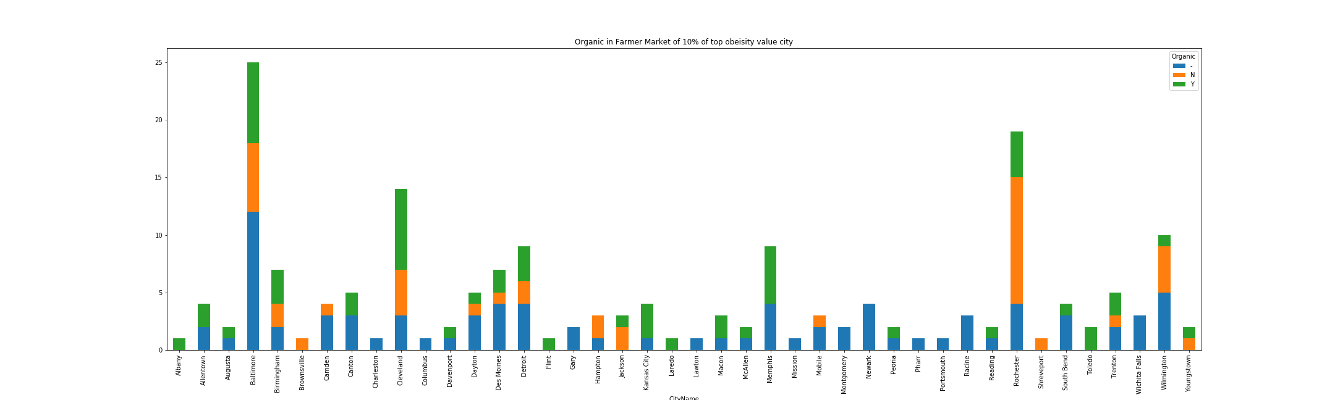
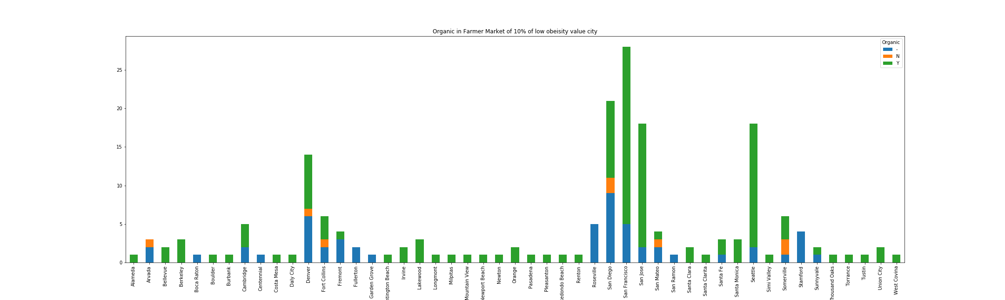
Cities with lower bmi have more farmers markets which sell organic foods

Slide 9
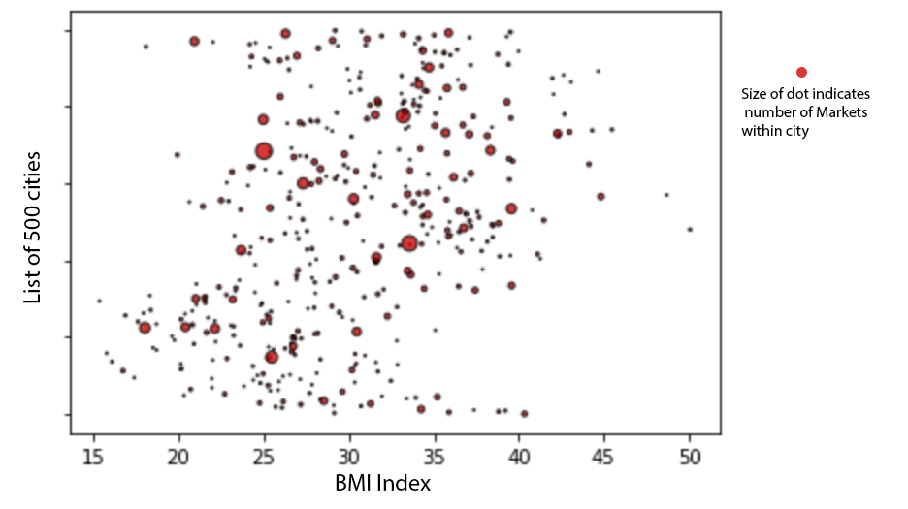

Slide 10
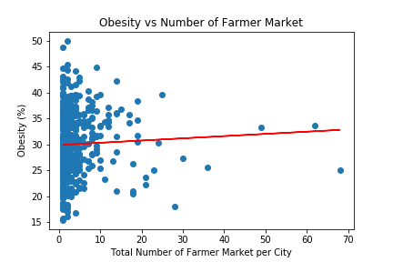

Slide 11
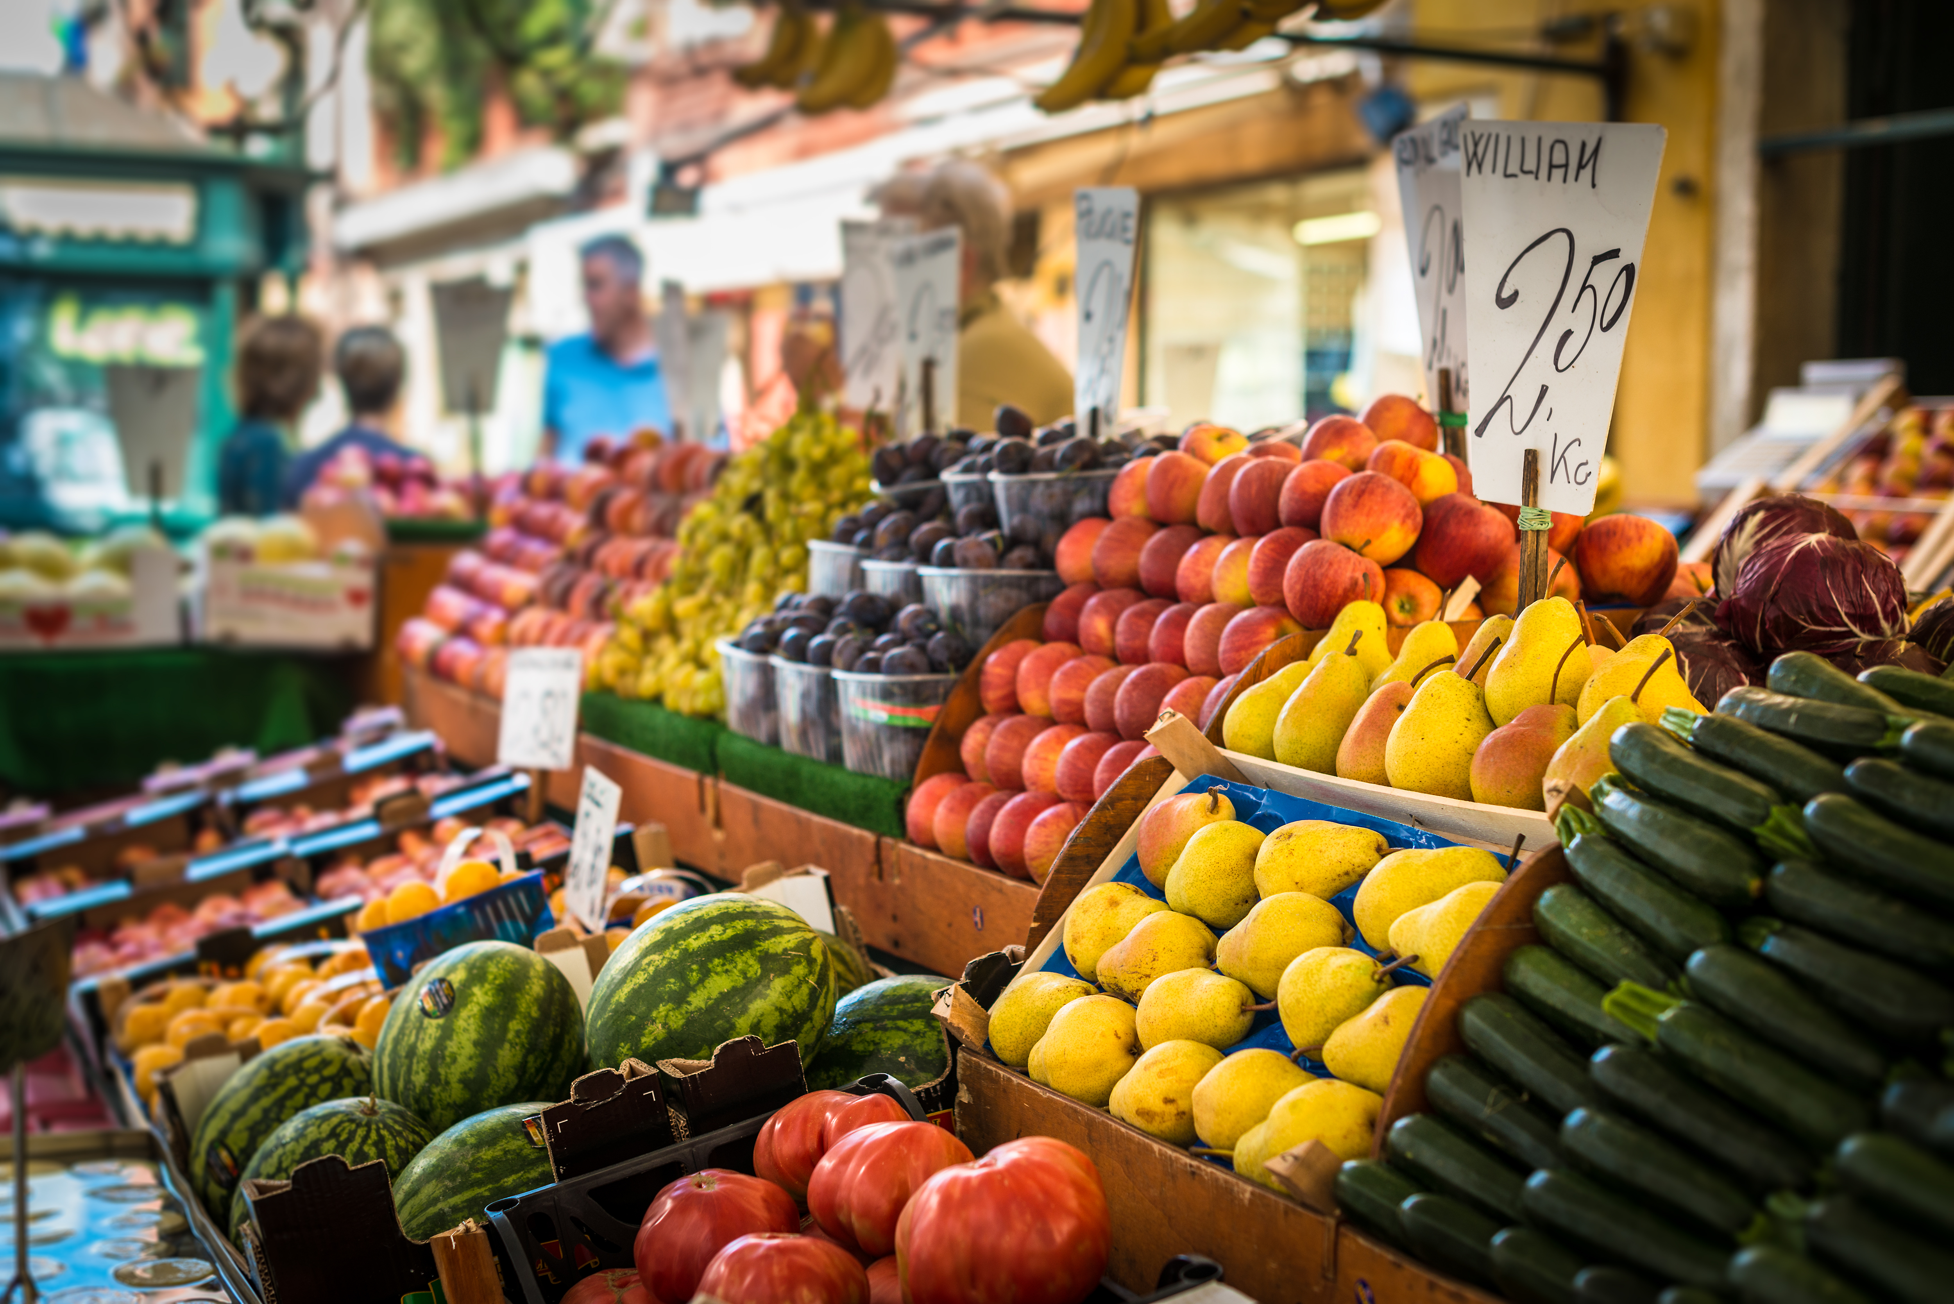
conclusion
Although there is no direct correlation between the presence of farmer’s markets and a lower prevalence of obesity, we can consider other factors.
Socioeconomic status among populations in US cities can be further analyzed in relation to the prevalence of Obesity.
Several states such as Baltimore and New York are implementing assistance programs to provide individuals increased access to purchase fresh foods and promoting implementation of farmers markets.

